Slide 1
mynetwork project (https://myprojectnetwork.com/)
Presented by: Group 6
Aparna Singh - 11814520
Dhyanesh Siva Sai Purna Mamilla - 11815670
Devendra Harsha Mamilla - 11818061
Umesh Chandra Vegineti - 11791519

Slide 2
Introduction
This project involves developing a website akin to platforms like leetcode, tailored to data science, analytics and machine learning. The platform offers users an interactive environment to solve programming platforms and track their progress. It aims to address two main issues to enhance their skills in data science and integrating real time problem solving with visualization tools and evaluate progress. The key features include user login with multi factor authentication, an embedded compiler, insights through data visualization, a payment gateway and robust security measures.
This initiative seeks to bridge the gap between theoretical knowledge and practical application in data science and machine learning. By providing a structured, engaging and interactive platform it empowers the users to hone their analytical and programming skills. The system is designed not only for individual learners but also for institutions and organizations aiming to up skill their teams while ensuring a comprehensive and scalable solution to mastering advanced technical concepts.

Slide 3
Project structure design

Slide 4
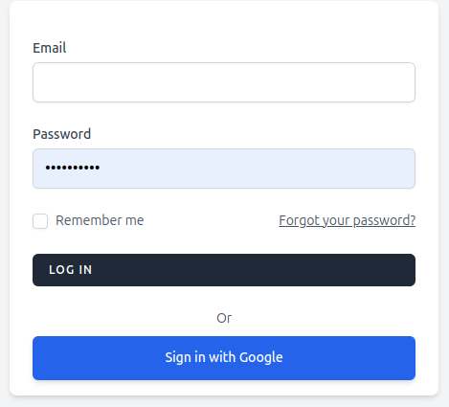
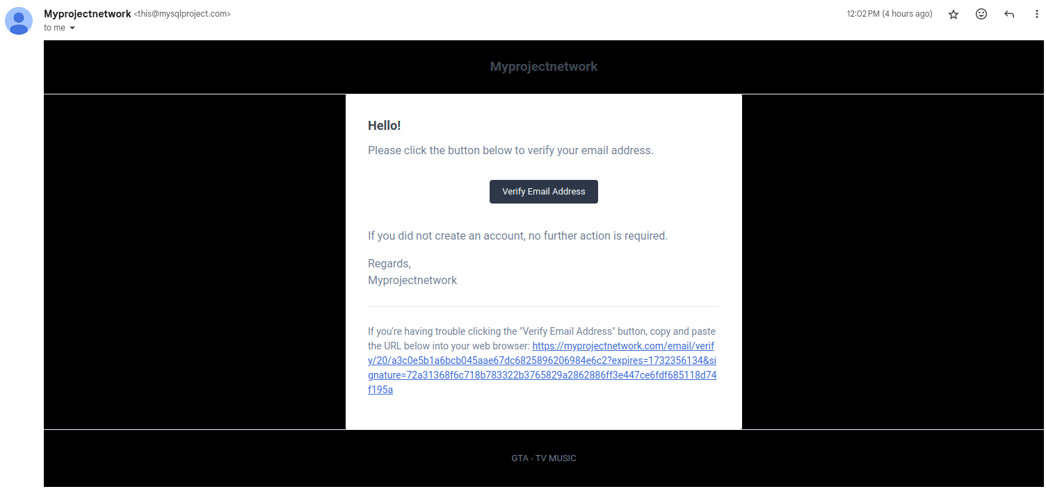
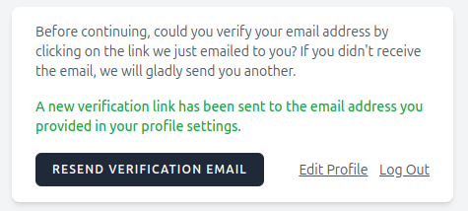
Users’ management:
Implements a secure login system with multi factor authentication.
This feature ensures that user accounts are protected against unauthorized access hence enhancing security
There are two login/ sign up options that is normal login
After successful sign up or sign email will be sent for verification

Slide 5
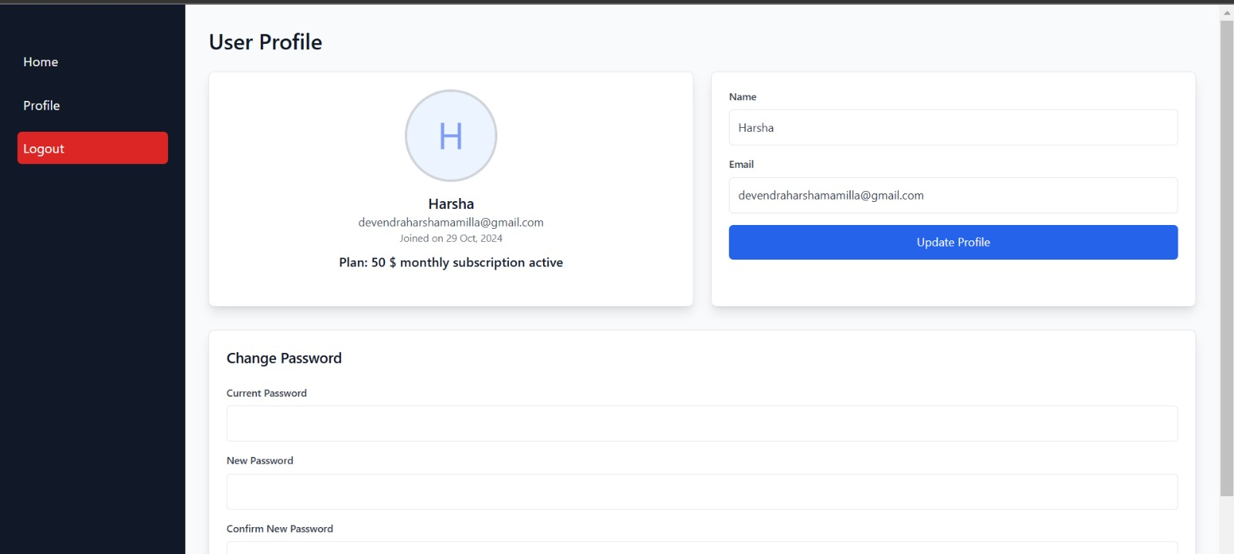
User Profile:
Allows users to update their personal information and subscription details easily.
The Change Password section ensures secure account access with the ability to update login credentials.

Slide 6
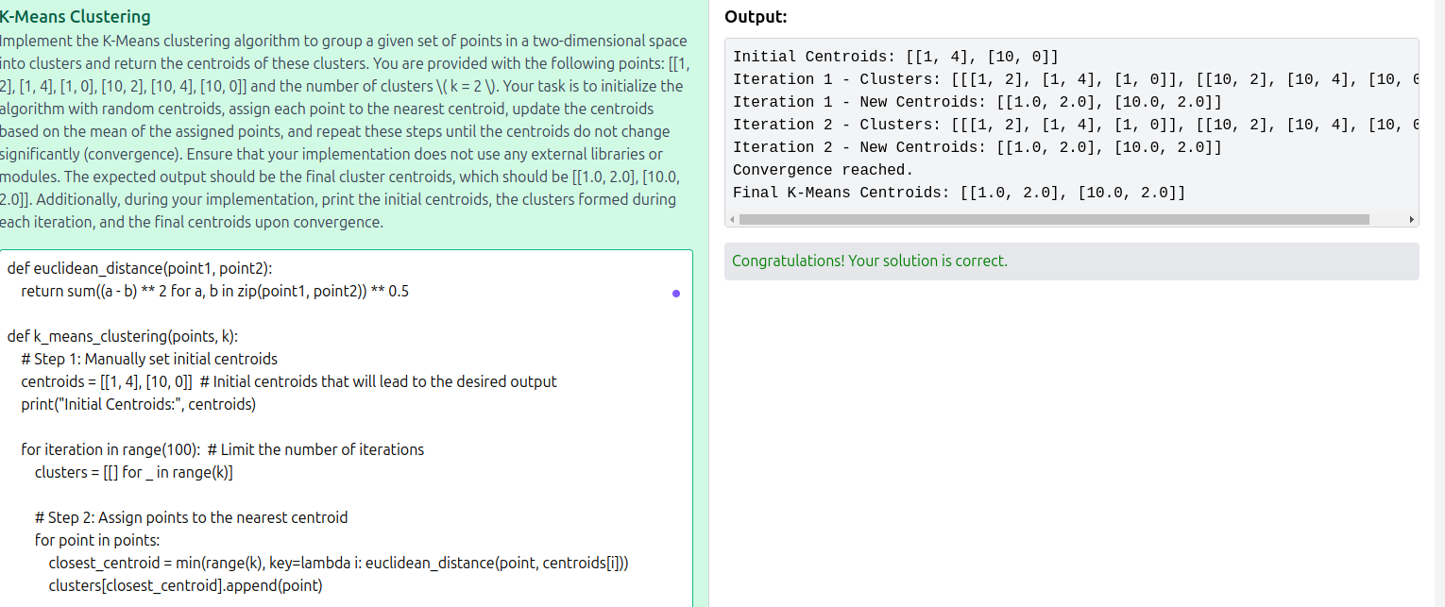
Project solver:
Displays the questions with an integrated compiler to execute code in real time.
This allows the user to interactively solve problems and receive immediate feedback on the submissions hence improving the learning experience

Slide 7
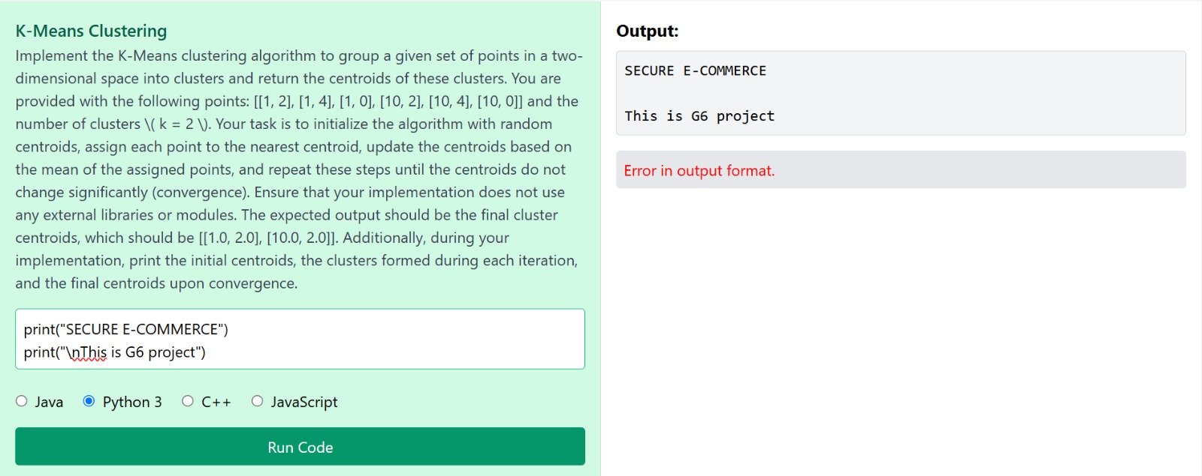
Project solver:
If there is a error in the output or if it doesn’t match with the question, Complier will highlight “Error in output format”
Through this, user can validate if the output is correct for the question that is being solved.

Slide 8
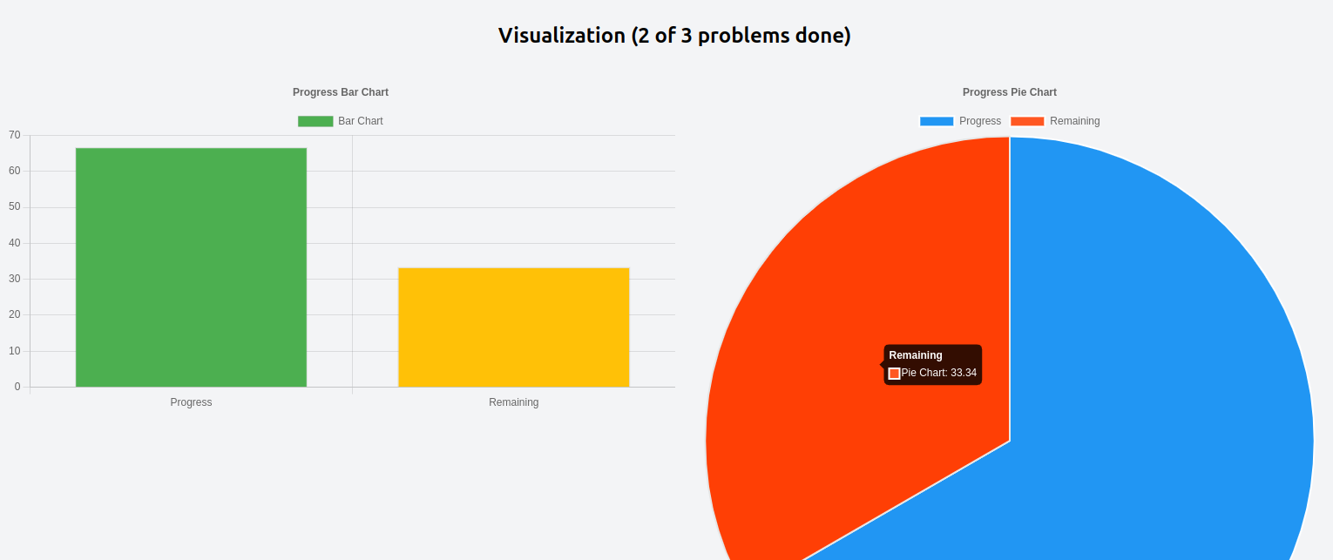
Data visualization:
Offers graphical insights like bar graphs and pie charts to track user progress.
Visual representation of data helps the users to understand their performance trends and identify the areas for improvement

Slide 9
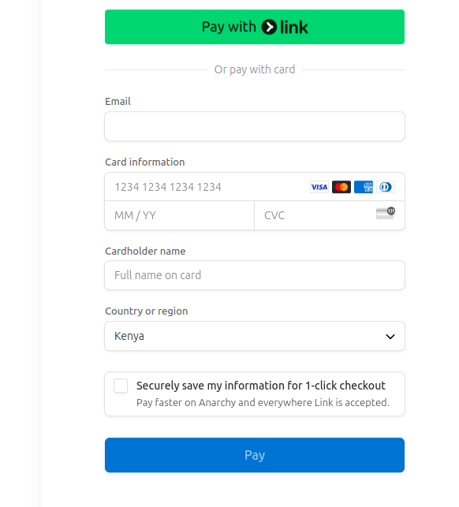
Payment gateway
Facilitates subscription payment securely.
The payment gateway is crucial for managing user subscriptions hence ensures the transactions are processed safely and efficiently

Slide 10
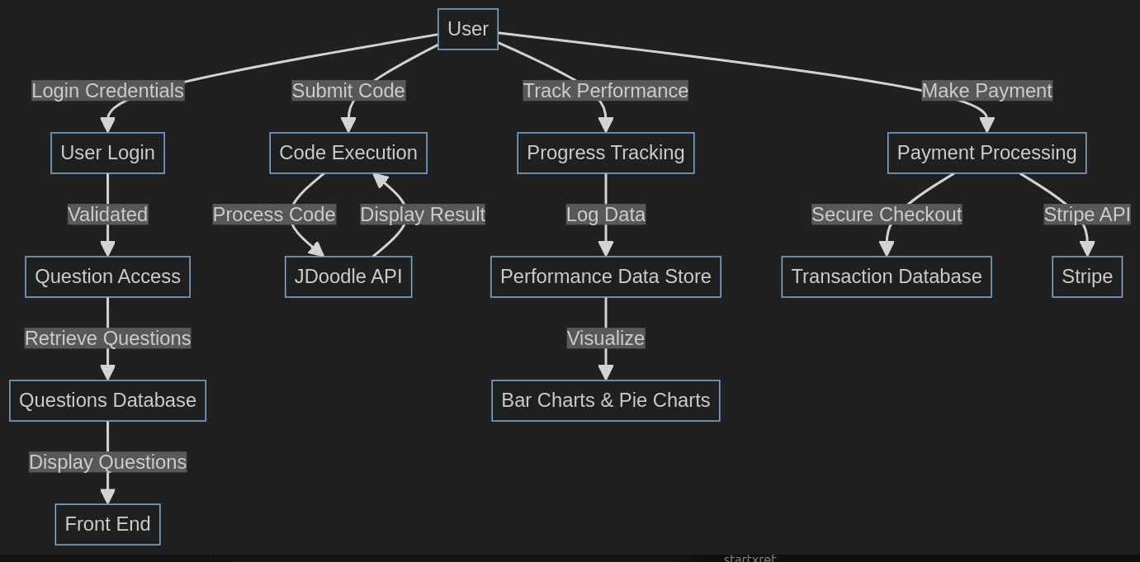
Data flow diagram
User login: User credentials are validated using multi factor authentication to ensure secure access. This process enhances security by requiring additional verification steps beyond username and password
Question access: Questions are retrieved from the database where they are seeded. Retrieved questions are then displayed in the front end for users to access. This ensures that the users have a seamless experience when interacting with available questions.
Code execution: The system features an inbuilt compiler that utilizes the jdoodle API and the submitted code is processed though this API, which returns the result for user review. This integration allows for efficient code execution and feedback.
Progress tracking: User performance data is logged and visualized using bar charts and pie charts. This helps the user understand their progress and areas of improvement.
Payment: Transactions are securely processed and stored in the database. To ensure secure checkout the stripe API is implemented. The integration facilitates safe and efficient payment processing

Slide 11
Result and analysis

Slide 12





Outcome
Developed interactive progress visualization too offering users insights into their performance
Integrated a real time python compiler for solving problems hence enhance user engagement and seamless experience
Implemented a secure a login system including a multi factor authentication that ensures user data protection
Added admin control and security features which includes user restrictions and login restrictions
Integrated a robust payment gateway supporting subscription models

Slide 13
Tools Used
Frontend: HTML, CSS. JavaScript, for responsive interface design
Backend: PHP, JavaScript
Platform : Laravel
Database: MySQL for managing user and problems data
Compiler: Jdoodle API for online compiler integration
Visualization: Chart.js and D3.js for data visualization
Security: Two factor authentication via Auth0 and secure login plug ins and email verification steps
Payment: Stripe API for subscription management.

Slide 14
Conclusion
The project encapsulates the development of an interactive platform aimed at enhancing skills in data science, analytics and machine learning. Its main accomplishments include robust user authentication a seamless problem-solving environment, dynamic visualization, secure payment processing and high-level security. Key takeaways highlight the importance of user centric design, integrating data insights and maintaining a strong security framework.
In conclusion, this project successfully delivers an interactive and feature rich platform that empowers users to develop and redefine their skills in programming. Its core achievements include a secure an efficient user authentication system, an intuitive problem-solving environment, advanced data visualization capabilities and a reliable payment gateway. This project underscores the value of user centric design, seamless integration of data insights and importance of robust security framework in building innovative educational tools.

Slide 15
References
Laravel documentation – A comprehensive guide to the laravel framework (https://laravel.com/docs)
Auth0 API implementation tutorial (https://auth0.com/docs/quickstart/webapp/laravel)
Jdoodle API documentation (https://www.jdoodle.com/integration)
Chart.js documentation (https://www.chartjs.org/docs/latest/)
Stripe documentation (https://stripe.com/docs/api)

Slide 16
Thank You!

